Slide 1



HEALTHCAR ANALYSIS REPORT
Author: Nandhakishore
i

Slide 2

CONTENTS
1. Task 1: Inner/Equi Join (Completed Appointments)
2. Task 2: Left Join (Patients with No Appointments)
3. Task 3: Right Join & Aggregates (Diagnoses per Doctor)
4. Task 4: Key Insights from Appointments and Diagnoses Mismatches
5. Task 5: Window Functions (Ranking Patients by Number of Appointments)
6. Task 6: Conditional Expressions (Age Groups)
7. Task 7: String Functions (Contact Numbers Ending with "1234")
8. Task 8: Subqueries (Patients Prescribed Only Insulin)
9. Task 9: Date & Time Functions (Average Medication Duration per Diagnosis)
10. Task 10: Complex Joins & Aggregation (Doctor with Most Unique Patients)

Slide 3

01
Task 1: Inner/Equi Join (Completed Appointments)

Slide 4

Key Insight from Result
The query returned 1000 rows, indicating that there are 1000 completed appointments in the database. This suggests that a significant portion of the scheduled appointments were completed, possibly more than originally expected.

Slide 5

02
Task 2: Left Join (Patients with No Appointments)

Slide 6

Key Insight
The query returned 662 rows, meaning 662 patients do not have any associated appointments in the system. This indicates that there are patients who have been recorded in the database but have never scheduled or attended an appointment, which might highlight areas for improving patient engagement or appointment scheduling.

Slide 7

03
Task 3: Right Join & Aggregates (Diagnoses per Doctor)

Slide 8

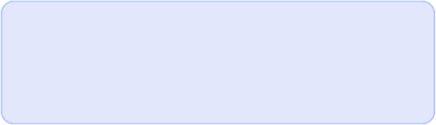
Right Join & Aggregates (Diagnoses per Doctor)
226 doctors out of 300 have no appointments, indicating a significant number of unutilized doctors.
74 doctors have at least one appointment, showing some patient engagement.
A small group of only 12 doctors have exactly two appointments, suggesting a low rate of repeat visits or that most appointments are for new patients.

Slide 9

04
Task 4: Key Insights from Appointments and Diagnoses Mismatches

Slide 10

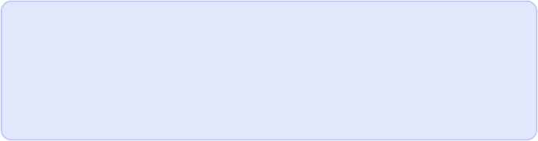
Key Insights from Appointments and Diagnoses Mismatches
Based on the analysis of the 10,226 rows of data, here are the key insights into the mismatches between appointments and diagnoses:
Significant Appointment-Diagnosis Mismatch: The data shows that there are 9,914 appointments that do not have a corresponding diagnosis. This represents the vast majority of appointment records and could be due to a lack of data entry, canceled appointments, or appointments that have not yet resulted in a formal diagnosis.
Data Integrity Check: There are zero diagnoses recorded in the system that do not have a corresponding appointment. This indicates that whenever a diagnosis has been recorded, it is properly linked to an appointment, which is a positive sign for data integrity.

Slide 11

05
Task 5: Window Functions (Ranking Patients by Number of Appointments)

Slide 12


Window Functions (Ranking Patients by Number of Appointments)
Low Patient Retention: The data shows a low rate of repeat appointments. The majority of the patients (9,928 out of 9,964 records) have only had one appointment.
Minimal High-Frequency Patients: No patients have a high number of appointments with any single doctor. The maximum number of appointments a patient has with a specific doctor is only two, with only a small number of patients (36) reaching this count.
Per-Doctor Focus: The ranking system effectively shows which patients are the most frequent for each individual doctor, rather than across the entire hospital. This highlights the patient engagement level on a doctor-by-doctor basis.

Slide 13

06
Task 6: Conditional Expressions (Age Groups)

Slide 14
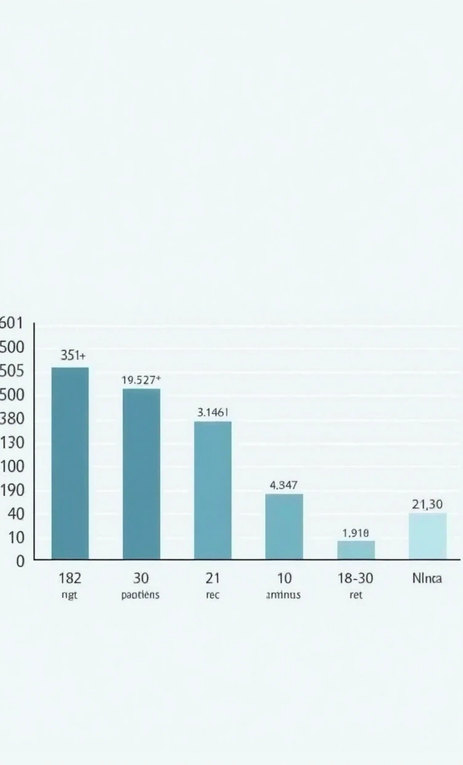
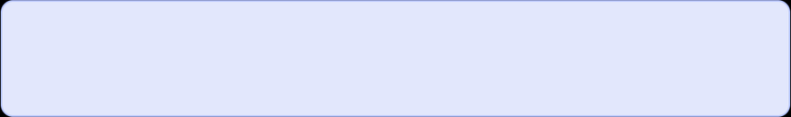
Age Group Distribution
51+
The largest age group is 51+, with 2,684 patients in this category, making up the majority of the patient base.
31-50
The 31-50 age group has 1,416 patients, representing a significant portion of the patient base.
18-30
The 18-30 age group is the smallest, with 900 patients, showing lower engagement or fewer healthcare needs in this younger demographic.

Slide 15

07
Task 7: String Functions (Contact Numbers Ending with "1234")

Slide 16

String Functions (Contact Numbers Ending with "1234")
The query returned 1 patient with the contact number ending in "1234" (PATIENT_1234), and their contact number is 98765431234.

Slide 17

08
Task 8: Subqueries (Patients Prescribed Only Insulin)

Slide 18

Subqueries (Patients Prescribed Only Insulin)
The query returned 252 rows, indicating that 252 patients have only been prescribed Insulin across all their diagnoses.

Slide 19

09
Task 9: Date & Time Functions (Average Medication Duration per Diagnosis)

Slide 20

Date & Time Functions (Average Medication Duration per Diagnosis)
Variable Treatment Durations: The average prescription duration varies significantly by diagnosis. For example, Migraine has the longest average prescription duration at 10.33 days, while Hypertension has the shortest at 3.90 days.
Data Anomaly: The result for Flu shows an average duration of -7.20 days. This is a negative value and indicates a significant data error in the DATEDIFF() calculation. It suggests that for these cases, the start_date is incorrectly recorded as being after the end_date. This specific finding highlights a critical data integrity issue that needs to be addressed.

Slide 21

10
Task 10: Complex Joins & Aggregation (Doctor with Most Unique Patients)

Slide 22

Complex Joins & Aggregation (Doctor with Most Unique Patients)
Doctor_37 (General Medicine) treated the most unique patients, with a total of 51 unique patients.

Slide 23
Thank You

